Slide 1

PowerPoint Presentation to Accompany
GO! with Microsoft® Word 2010
Chapter 1
Creating Documents with Microsoft Word 2010

Slide 2
Objectives
Create a New Document and Insert Text
Insert and Format Graphics
Insert and Modify Text Boxes and Shapes
Preview and Print a Document

Slide 3
Objectives
Change Document and Paragraph Layout
Create and Modify Lists
Set and Modify Tab Stops
Insert a SmartArt Graphic

Slide 4
Create a New Document and Insert Text
Start new Word document
  Type text
  Select font and font size
  Use formatting marks
  Insert text from a file

Slide 5
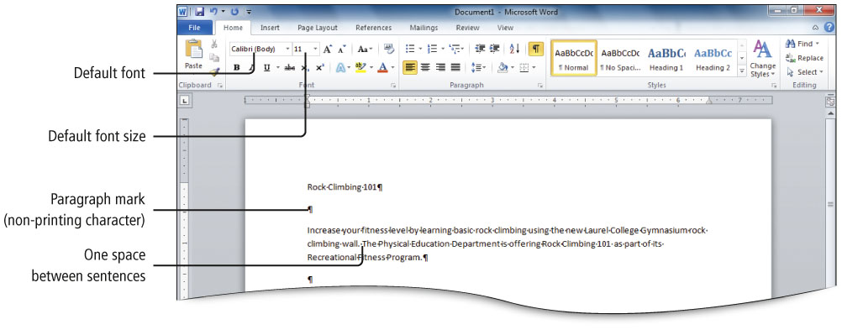
Create a New Document and Insert Text
Notes:
Figure 1.3

Slide 6
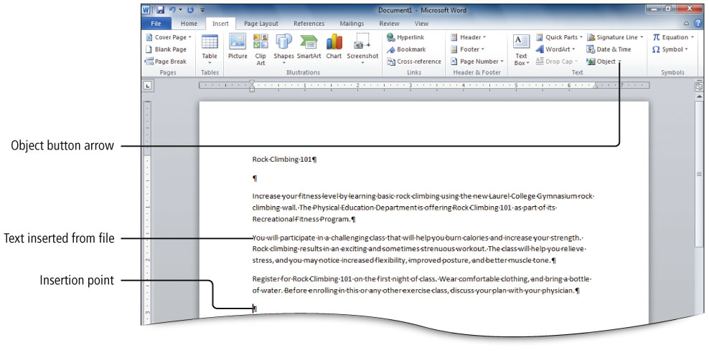
Create a New Document and Insert Text
Notes:
Figure 1.4

Slide 7
Insert and Format Graphics
Format text using text effects, which are decorative formats
  Shadowed or mirrored text
  Text glow
  3-D effects
  Colors that make text stand out
Notes:
Figure 1.5

Slide 8
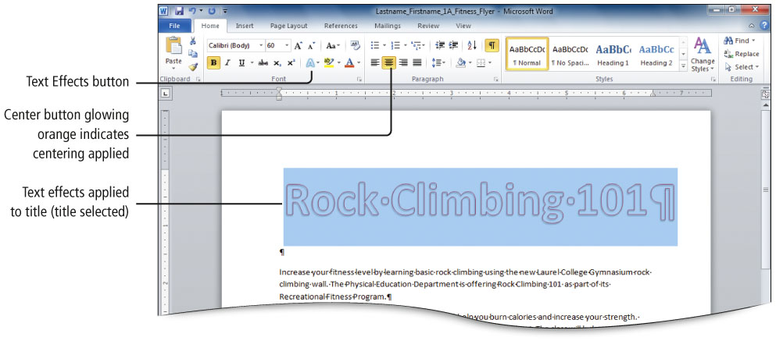
Insert and Format Graphics
Notes:
Figure 1.5

Slide 9
Insert and Format Graphics
Pictures inserted into a Word document often need to be resized and repositioned.
Use the sizing handles and rotate handle to make changes to your inserted picture.

Slide 10
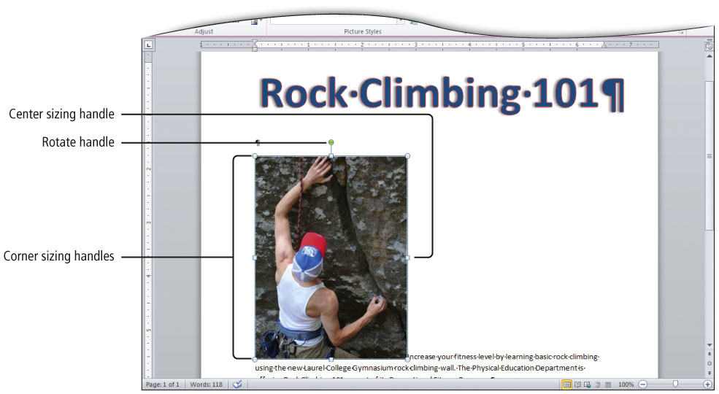
Insert and Format Graphics
Notes:
Figure 1.7

Slide 11
Insert and Format Graphics
Text wrapping—how the text displays around an object, such as a photo
  Use the Wrap Text button to display a gallery of text wrapping arrangements.
The arrow keys on your keyboard nudge—move in small increments—your selected object.

Slide 12
Insert and Format Graphics
Picture styles include shapes, shadows, frames, borders, and other special effects to stylize an image.
  Click on the Format tab, in the Picture Styles group, the Picture Effects button to select a style.
Artistic effects formats make pictures look more like sketches or paintings.
  Click on the Format tab, in the Picture Styles group, the Picture Effects button to select a style.

Slide 13
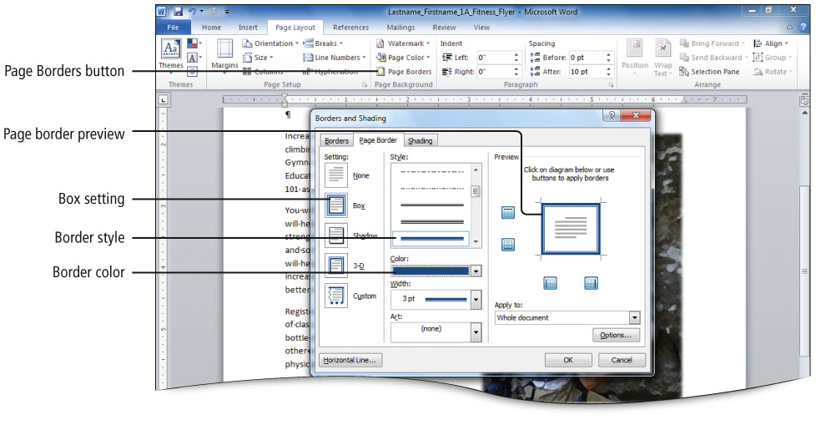
Insert and Format Graphics
Page borders frame the page and help focus the information on the page.
Notes:
Figure 1.13

Slide 14
Insert and Modify Text Boxes and Shapes
Predefined shapes and text boxes are provided to add visual interest to documents.
  Shape—an object such as a line, arrow, box, callout, or banner
  Text box—a movable, resizable container for text or graphics
  Both are floating objects and can be placed anywhere on the page.

Slide 15
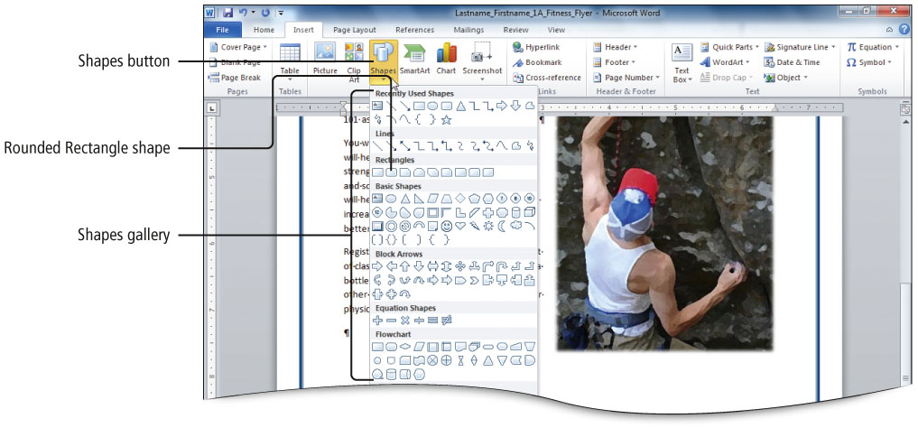
Insert and Modify Text Boxes and Shapes
Notes:
Figure 1.15

Slide 16
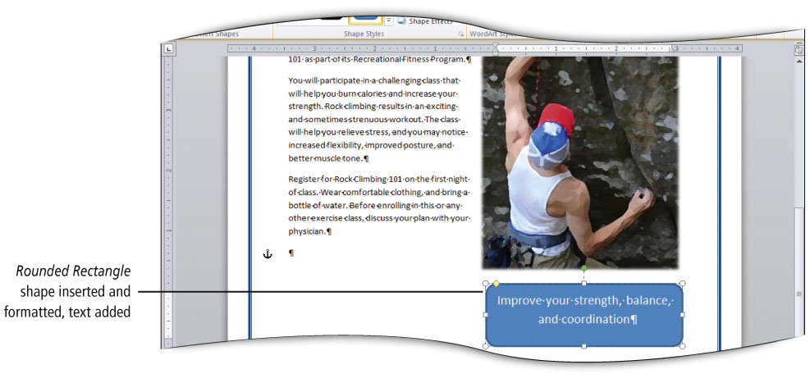
Insert and Modify Text Boxes and Shapes
Notes:
Figure 1.16

Slide 17
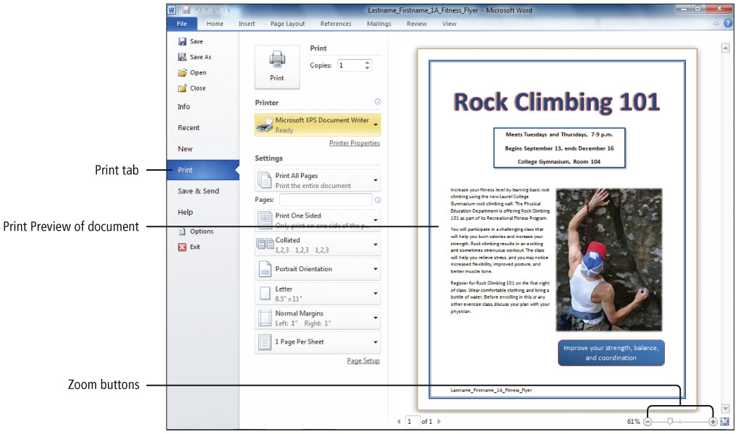
Preview and Print a Document
Notes:
Figure 1.22

Slide 18
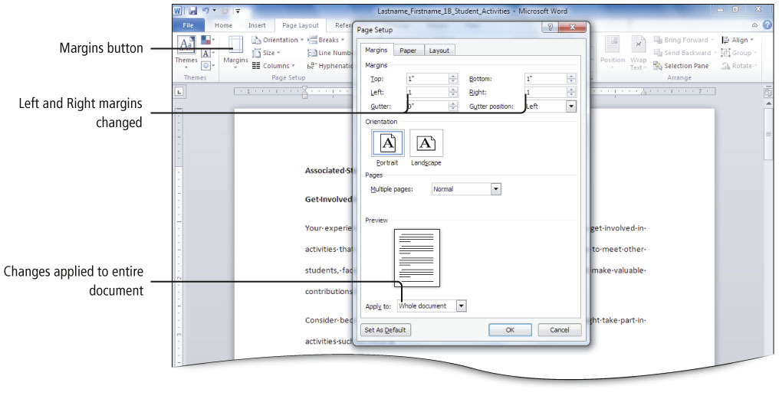
Change Document and Paragraph Layout
Setting margins
Notes:
Figure 1.24

Slide 19
Change Document and Paragraph Layout
Alignment —placement of paragraph text relative to the margins
  Left alignment—align left margin, uneven right margin
  Center alignment—centered between margins
  Right alignment—align right margin, uneven left margin
  Justified alignment—align evenly at left and right margins

Slide 20
Change Document and Paragraph Layout
Line spacing—distance between lines of text in a paragraph
  Single spacing (business documents)
  Multiple 1.15 spacing (default line spacing)
  Double spacing (academic papers)

Slide 21
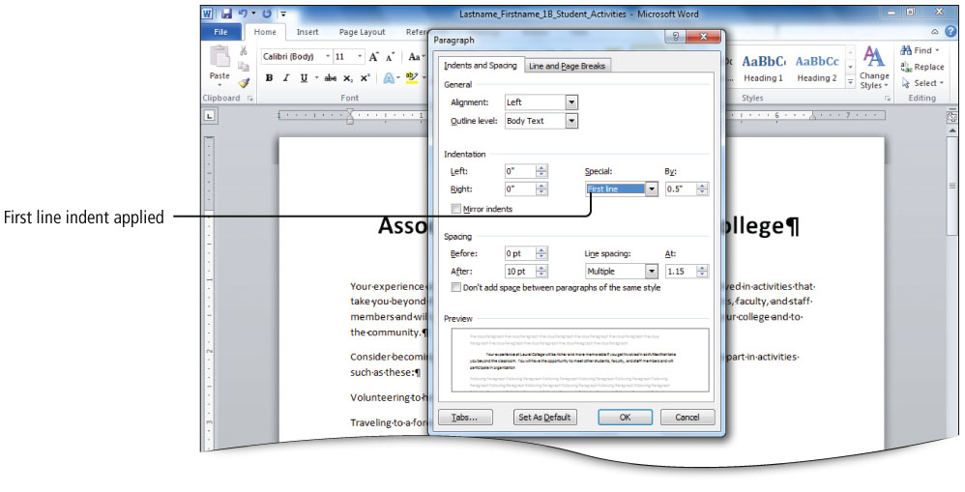
Change Document and Paragraph Layout
Notes:
Figure 1.30

Slide 22
Create and Modify Lists
Bulleted list
  Items of list can be introduced in any order
  Uses bullets—text symbols such as small circles or check marks—to introduce each item in a list
Numbered list
  Items with consecutive numbers
  Use where order is important

Slide 23
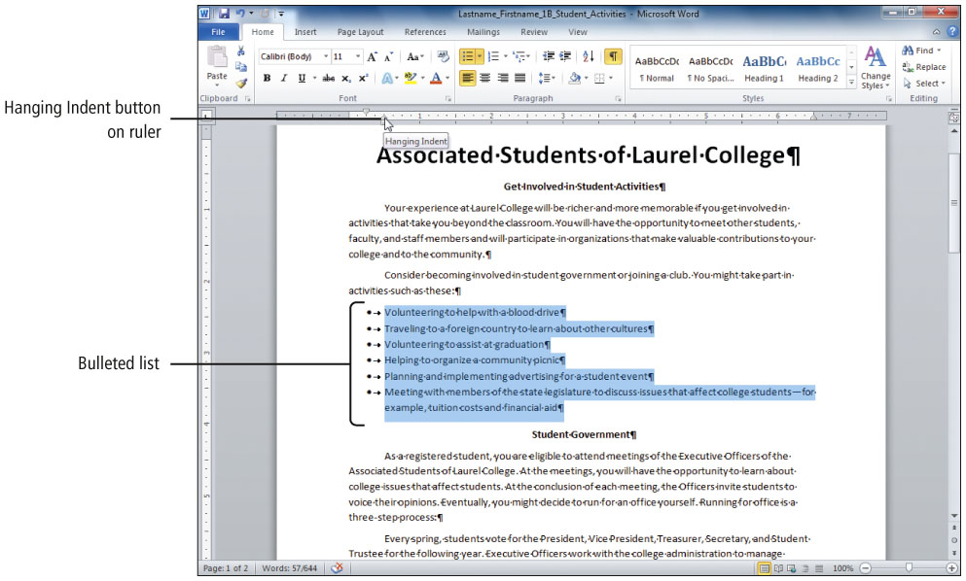
Create and Modify Lists
Notes:
Figure 1.34

Slide 24
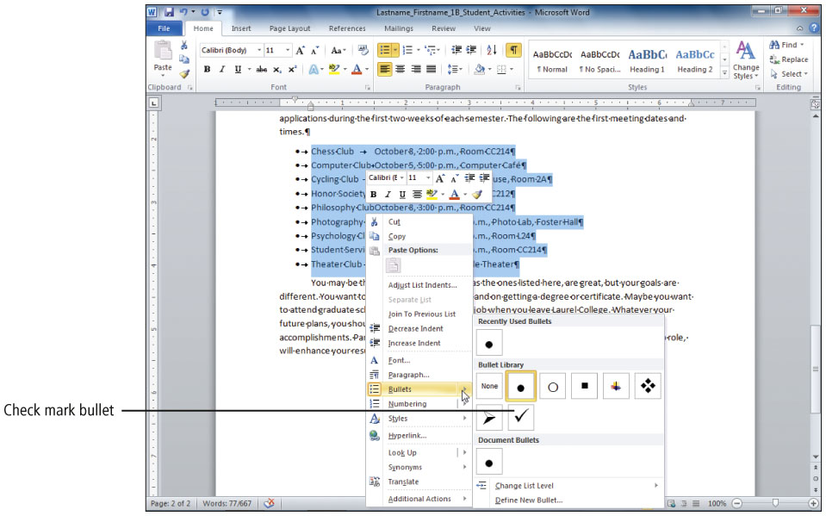
Create and Modify Lists
Notes:
Figure 1.39

Slide 25
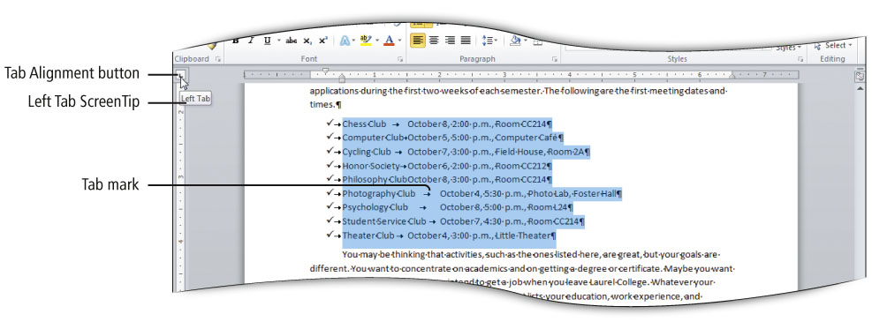
Set and Modify Tab Stops
Notes:
Figure 1.41

Slide 26
Set and Modify Tab Stops
Tab Alignment Options
Type | Description
Left | Text is left aligned at the tab stop and extends to the right.
Center | Text is centered around the tab stop.
Right | Text is right aligned at the tab stop and extends to the left.
Decimal | The decimal point aligns at the tab stop.
Bar | A vertical bar displays at the tab stop.
First Line Indent | Text in the first line of a paragraph indents.
Hanging Indent | Text in all lines except the first line in the paragraph indents.

Slide 27
Set and Modify Tab Stops
Tab stops—a form of paragraph formatting
  Information about tab stops is stored in the paragraph mark.
  Use the Tab key to move to tab stops.

Slide 28
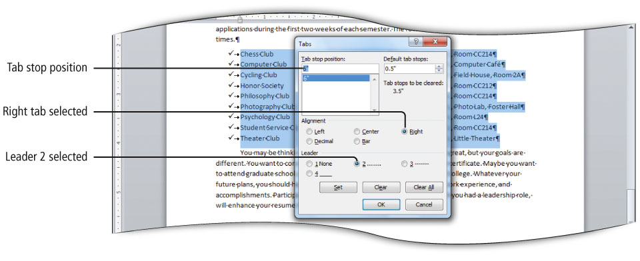
Set and Modify Tab Stops
Notes:
Figure 1.44

Slide 29
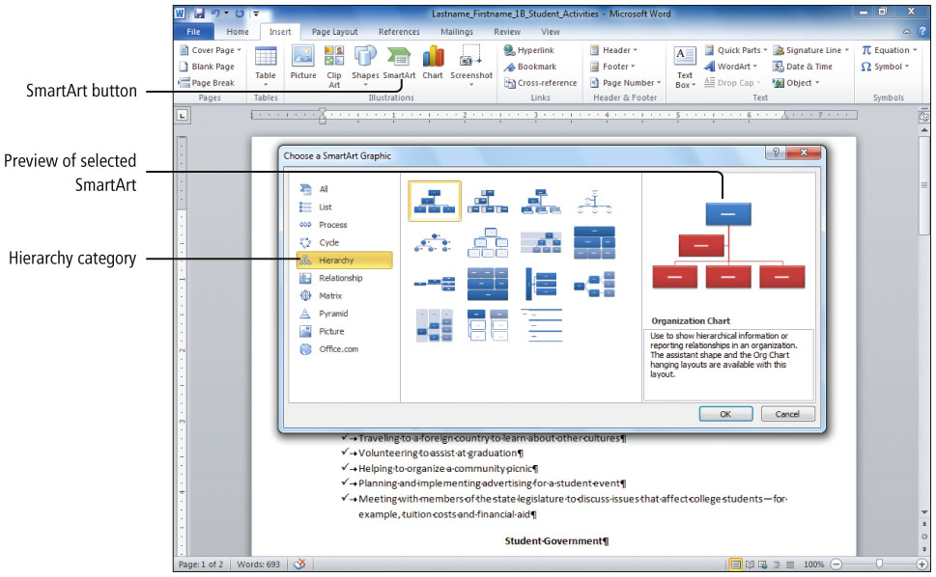
Insert a SmartArt Graphic
Notes:
Figure 1.46

Slide 30
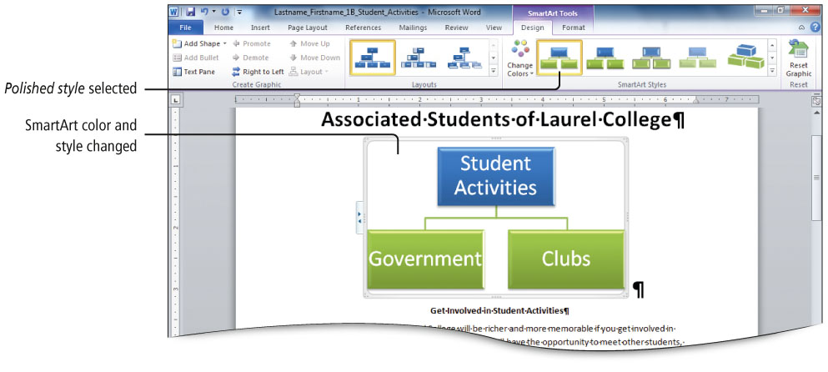
Insert a SmartArt Graphic
Notes:
Figure 1.49

Slide 31
Covered Objectives
Create a New Document and Insert Text
Insert and Format Graphics
Insert and Modify Text Boxes and Shapes
Preview and Print a Document

Slide 32
Covered Objectives
Change Document and Paragraph Layout
Create and Modify Lists
Set and Modify Tab Stops
Insert a SmartArt Graphic

Slide 33
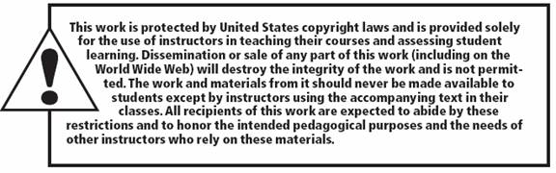
All rights reserved. No part of this publication may be reproduced, stored in a retrieval system, or transmitted, in any form or by any means, electronic, mechanical, photocopying, recording, or otherwise, without the prior written permission of the publisher. Printed in the United States of America.
Copyright © 2011 Pearson Education, Inc.
Publishing as Prentice Hall

